Slide 1
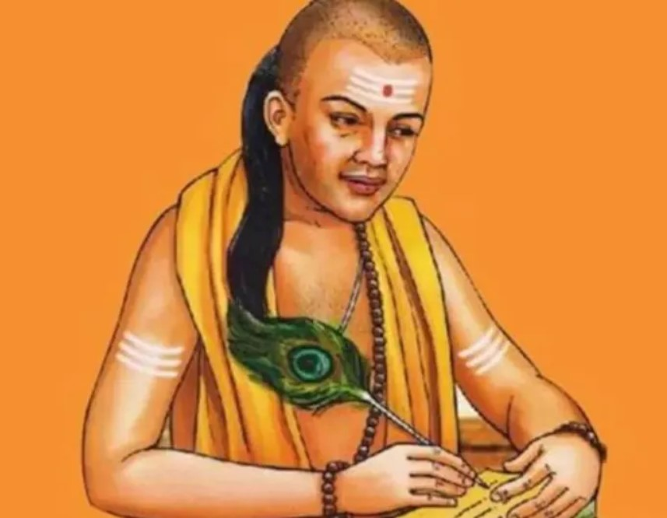
Kautilya’s Arthashastra and its Contemporary Relevance

Slide 2
Introduction
Vishnugupta, popularly known as Kautilya or Chanakya was the prime minister of Chandragupta Maurya – the king of Magadha.
Kautilya’s Arthashastra is the oldest and most exhaustive treatise on statecraft and on issues of diplomacy, war, peace, intelligence, security, and political economy.
It is fundamentally a book of state management and a guide to the means of procurement and preservation of wealth.
Primarily a guide for the king to rule with justice and equity while ensuring protection and prosperity to his subjects.

Slide 3
Cont….
The text is divided into 15 chapters dealing with subject matters on:
Polity
Economy
Society
It puts emphasis on two broad objectives: Resource maximization and their optimum management.
Suggests the methods of resource collection which may bring about maximum prosperity without killing the economic incentives

Slide 4
Key Aspects
Arthashastra regards the King to be the key
in the working of the state administrative machinery
looking after education of the princes
duties as a king
selection of ministers
organisation of the different departments of the state, Justice, Taxation, Foreign policy, etc. – Ultimate source of the prosperity of the kingdom.

Slide 5
Four Upayas or Ways of Realizing Aims
Four Upayas as ways to reach solutions in State Politics
The four upayas or approaches or ways of realizing aims or objects of diplomacy
Sama: Conciliation (the process of ending discord)
Dana: Gifts/Generosity
Bheda: Rupture
Danda: Force
The means of overcoming opposition is based on overlapping in four upayas and six gunas.

Slide 6
Sadgunya: The Measures of Foreign Policy
The foreign policy consists of six gunas or policies.
1)Samdhi: Making a treaty containing conditions or terms, i.e., the policy of peace
2) Vigraha: The policy of hostility
3) Asana: The policy of remaining quiet (and not planning to march on an expedition)
4) Yana: Marching on an expedition
5) Samsraya: Seeking shelter with another king or in a fort
6) Dvaidhibhava: Double policy of Samdhi with one king and Vigraha with another simultaneously
The general rule is that
when one is weaker than the enemy, samdhi is the policy to be followed.
if stronger than him, then vigraha.
If both are equal in power, asana is the right policy.

Slide 7
Seven Prakrits or Constituent Elements of a State
Svamin (king or ruler)
Amatya (body of ministers and structure of administration)
Janapada/Rastra (territory being agriculturally fertile with mines, forest and pastures, water resources and communication system for trade)
Durga/Pura (fort)
Kosa (treasury)
Danda/Bala (army)
Mitra (ally)

Slide 8
Vijay or Conquest and Yuddha or War
Conquest is of three types:
Dharmavijay (Righteous)
Lobbhavijay (Greedy)
Asuravijay (Demoniacal)
Yuddha or war is also of three kinds:
Prakash-yuddha, ‘open fight’ at a place and time indicated
Kuta-yuddha ‘concealed warfare’ involving use of tactics in battlefield
Tusnim- yuddha ‘silent fighting’ implying the use of secret agents for enticing enemy officers or killing them

Slide 9
Kautilya’s ArthasHastra and the Contemporary Economics

Slide 10
Demand and Supply
Kautilya’s concepts are familiar with the modern day’s concepts of demand and supply and their combined influence on the determination of prices.
A king should not arbitrarily fix the price of a product without regard to its supply and demand situations.
Without proper consideration of demand and supply, price cannot be an equilibrium price which can maximize the welfare of consumers and producers.
This idea is quite similar to the ‘invisible hand’ of Adam Smith.
Kautilya was aware of the monopoly elements. Hence, he set the profit limit that take care of both.
Businessmen were allowed to 5 to 10 percent profit (Sarkar, 2000).

Slide 11
Demand and Supply Cont….
The state-owned business and private business were seen during Kautilya’s era: Mixed Economy
The conflict of interests between them is natural.
Kautilya prescribed the policy to remove the conflict via
some parity in prices such that it should not stifle the incentive for the private sector.
State should not dictate the prices without consideration of
cost of production
the ratio of supply to demand
the reasonable level of profit
In the situation of over-production state was expected to intervene and centralize the sales so that price should not fall from a certain minimum level, popularly known as price floor ( Kangle, 1960).

Slide 12
International Trade
Kautilya recognized that international trade in goods and services is a major vehicle for increasing the sovereign’s wealth and that of his subjects.
Merchants were important for trade.
As they did not generate any form of material wealth, price distortions from their high profit margins or other speculative behavior were put under strict control (monetary fines and taxes).
Kautilya was not concerned with the balance of payments equilibrium.
Import was oriented toward wealth creation.
Commodities not produced domestically or available at high prices (high costs of production) were imported.
The principle of comparative advantage was used in advancing exports to regions and areas generating profits, while unprofitable areas were avoided.

Slide 13
International Trade Cont…
Exception was made in the case of exporting commodities to possible future allies or strategic trade partners.
A complete system of trade tariffs, price subsidy and trade control system was set up to facilitate and safeguard trade activities.
Terms of trade had also an important role in the trade system with maximizing or minimizing (avoiding losses) the export/import price difference.
Strategic partners were to be attracted through bilateral agreement and two-way trade policies (comparative advantage favouring both nations).
Kautilya advocated for attracting foreigners who possess good technical and other economic development of the realm.
He suggested heavy taxes for the luxury imported goods but light taxes on essential goods.
He supported the use of tariffs, both import and export duties, primarily as revenue-raising devices for the monarch rather than as mechanisms for altering trade patterns.
Import rates generally ranked between 4% and 20%.

Slide 14
Comparing Market Economy with Kautilya’s Economy
Modern market economy | Kautilya’s market economy
• Private ownership - capital and resources owned by individuals | • Private and State ownership - capital and resources owned by a State and individuals (Mixed Economy)
• Price system - used to allocate resources in the economy by the forces of supply and demand | • Price system - used to allocate resources in the economy by the forces of supply and demand under government’s supervision and intervention
• Entrepreneurship - invisible hand and risk-taking | • Entrepreneurship - invisible hand under government’s supervision and controlled risk-taking
• Competition - rivalry between buyers and sellers on the market, encouraging efficient use of resources in the production process | • Competition - rivalry between buyers and sellers under the control of the State, promoting and safeguarding efficient and sustainable use of resources.
• Existence of moral-hazard problem (a situation where an economic actor has an incentive to increase its exposure to risk because it does not bear the full costs of that risk.) | • Controlled moral hazard by the State
Efficient Market Economy | Moral Market Economy

Slide 15
Principles of Taxation
The wealth and well-being can be most advanced by a fair and efficient system of taxation.
Should supply the King with tax revenue while not stifling economic growth.
Kautilya enunciates a set of ‘principles of taxation’ similar to the criteria formulated by Adam Smith as ‘canons of taxation’ in his Wealth of Nations.
Canon of Equality (burden must be distributed equitably among the taxpayers.)
Canon on Certainty (must be certain to the taxpayers and tax-levying authority)
Canon of Economy (the expenses of collection of taxes should not be excessive.)
Canon of Convenience (convenient for the contributor to pay it)
Taxing power be limited (Tax base should be increased not the tax rate)
Tax increase should be graduated

Slide 16
Principles of Taxation Cont…
Kautilya recognized that a prosperous and stable kingdom has to be founded on a well-developed and administered tax system.
Kautilya’s advice on the ideal tax system was based on achieving the objectives:
Gaining as much tax revenue as possible for the king
Promoting economic growth and development
Ensuring that resources are used efficiently
Applying taxes that are ‘fair’ and ‘just’
In ideal Kautilyan State, the revenue came for the Monarch from two sources
Sales of the Minerals, timber and agricultural products
Taxes from private income, wealth and products, including foreign trade

Slide 17
Labor Theory of Value
Kautilya advocated a wage system based on the economic value created and encouraged people to work harder and more efficiently.
Kautilya recognized three distinct components for determining the market value of labor:
The level of skill required (the human capital)
Labor hours worked, and
Units of output produced (the labor productivity)

Slide 18
Labor Theory of Value
For wages not previously settled, the amount shall be fixed in proportion to the work done and the time spent in doing it.
Wages being previously unsettled,
A cultivator shall obtain 1/10th of the crops grown
A herdsman 1/10th of the clarified butter,
A trader 1/10th of the sales proceeds (Shamasastry, p 208)
To prevent deception by employers, cultivators or merchants shall either at the end or in the middle of their cultivation or manufacture pay the labourers proportionate wages.
Payment to workers is not contingent on marketing of goods (Nagarajan, p 114)

Slide 19
Athashastrá’s Relevance in History
Johann Jakob Meyer, the German Indologist and translator of the Arthasastra from Sanskrit to German language in 1927 said that the Arthasastra was not a book but a library of ancient India.
Masashi Okuyama, Senior Researcher, International Peace Association, Japan has mentioned that geopolitics and its practice has been always present in India throughout history and one earliest example of this is Kautilya’s Arthasastra.
L.N. Rangarajan, a diplomat who has worked on the Arthasastra, argued that in so far as the nature of human beings remains the same and states behave in the manner as they always have done, Kautilya becomes relevant.
Some of the Kautilya’s classical maxims are:
What produces unfavourable results is bad policy.
When the advantages to be derived from peace and war are equal one should prefer peace…. Similarly, if the advantage to be derived from neutrality and war are equal, one should prefer neutrality.

Slide 20
References/Suggested Readings
L N Rangarajan (1992). Kautilya: The Arthashastra, Edited, rearranged, Translated and Introduced, Penguin Books, India.
Charles Waldauer, William J. Zahka and Surendra Pal (1996). Kautilya's Arthashastra: A Neglected Precursor to Classical Economics, Indian economic Review, Vol. 31, No. 1 (January-June 1996), pp. 101-108.
Marinko Škare (2013). The missing link: From Kautilya’s The Arthashastra to modern economics, The Journal of Philosophical Economics, Vol 6, No. 2, pp 1-31
Balbir Sihag: Kautilya and Modern Economics, University of Massachusetts
S S Roy (2018). Kautilya’s Arthashastra and Modern Economics, St. Theresa International College
Sriram Balasubramanian (2022). Kautilyanomics: For Modern Times, Bloomsbury.

